Slide 1
Data Structures

Slide 2
Agenda
Sorting – Bubble, Insertion, Selection
Some Problems

Slide 3
Selection Sort

Slide 4
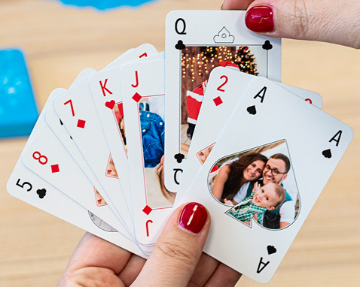
Insertion Sort

Slide 5
Insertion Sort

Slide 6
Insertion Sort

Slide 7
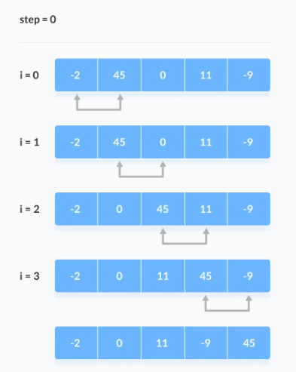
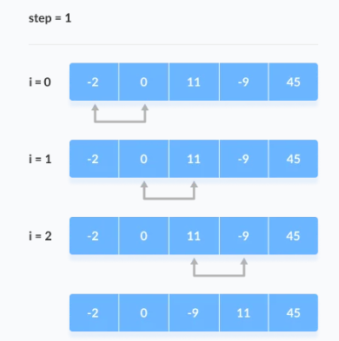
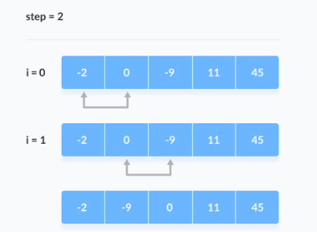
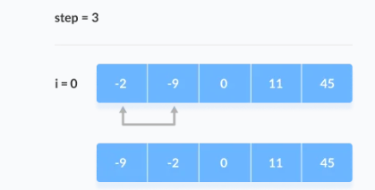
Bubble Sort

Slide 8
Bubble Sort

Slide 9
Bubble Sort

Slide 10
THANK YOU

